Slide 1

Node with Fixed Values - tf.constant

Slide 2
Reference
tf.constant
Youtube
Code

Slide 3
TensorFlow Version

Slide 4
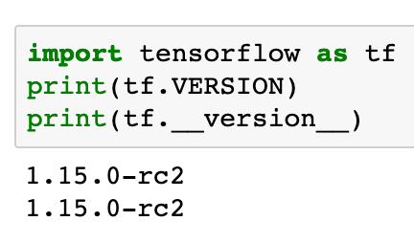

Slide 5
tf.constant

Slide 6
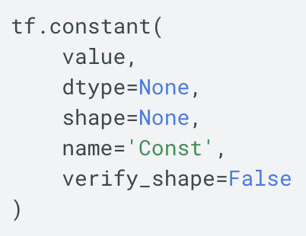

Slide 7
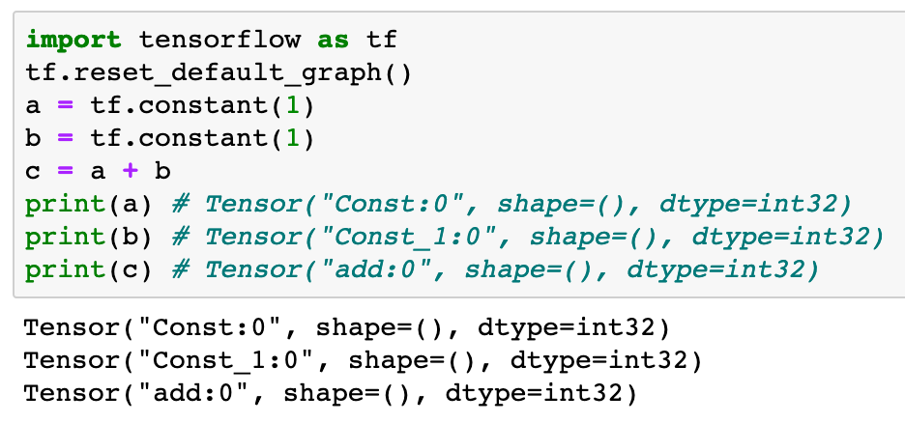

Slide 8
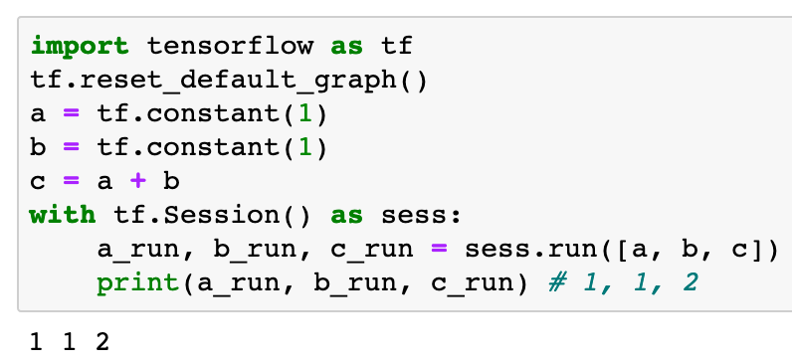

Slide 9
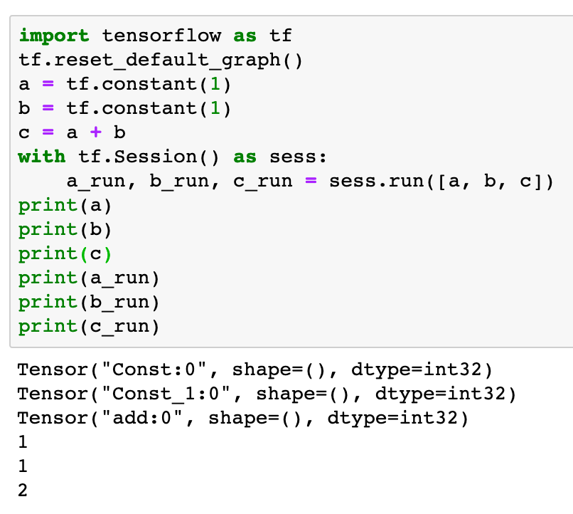

Slide 10
type

Slide 11
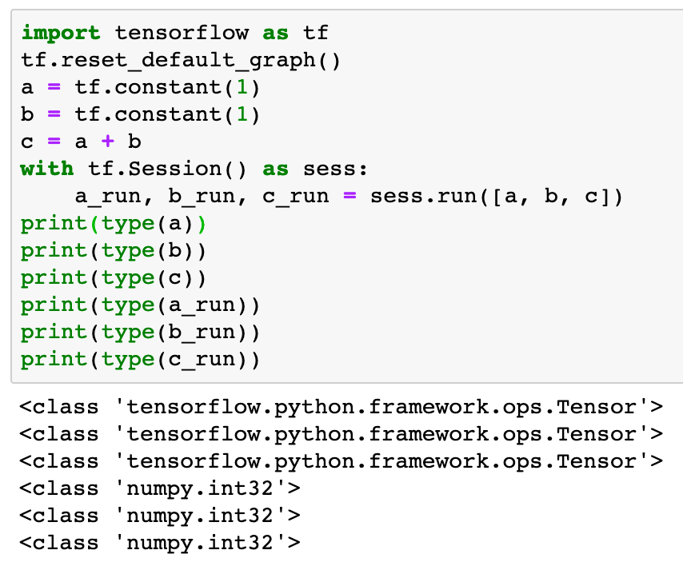

Slide 12
dtype

Slide 13
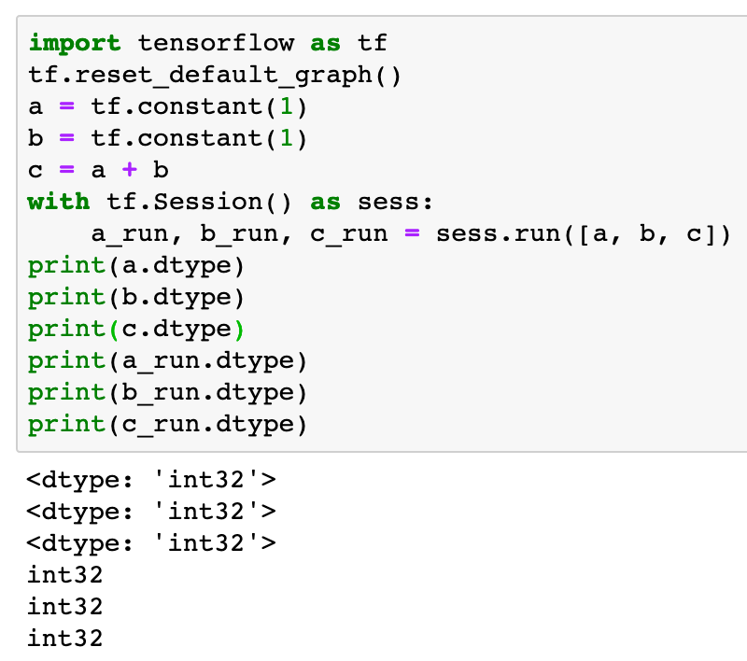

Slide 14
shape

Slide 15
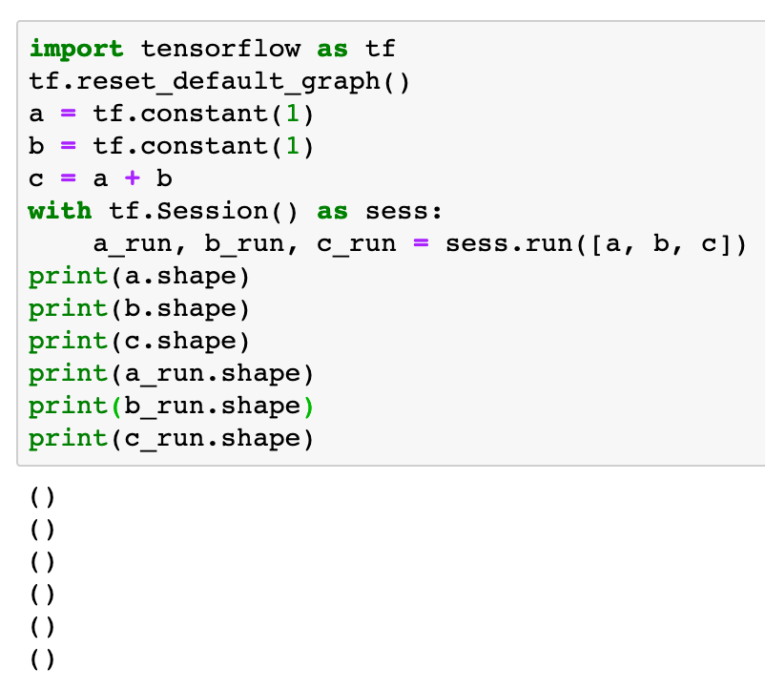

Slide 16
name

Slide 17
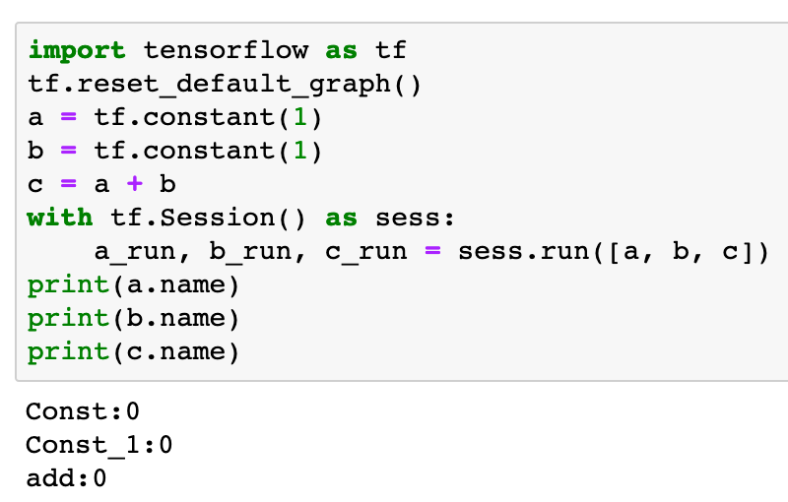

Slide 18
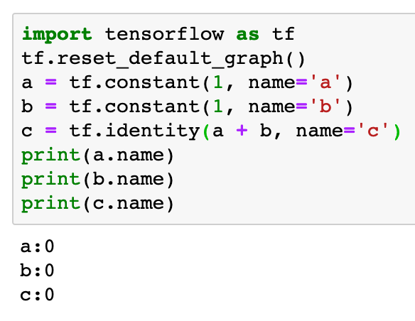

Slide 19
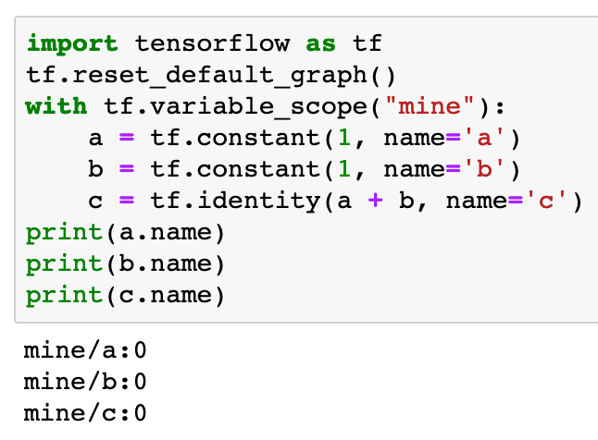

Slide 20
Now
Let’s Play with Code

